Slide 1
Attention Is All You Need
Speaker: Yin Hsiang Liao
Advisor: Jia Ling Koh
Date: 2019 April 29th
Source: NIPS 2017

Slide 2
Outline
1. Introduction
2. Model Architecture
2.1 Overview
2.2 Encoder & Decoder (1)
2.3 Attention
2.4 Encoder & Decoder (2)
3. Result & Conclusion

Slide 3
Introduction
1
Let’s start with the RNN-based structure.

Slide 4
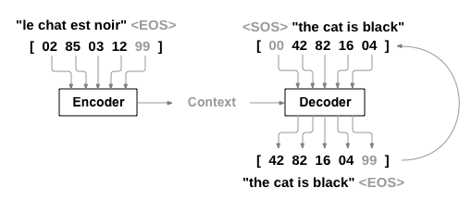
Seq2Seq
1. No long-term dependency
2. Less parallelizable

Slide 5
Seq2Seq & Attention
1. No long-term dependency
2. Less parallelizable: slower, constraint by RAM

Slide 6
Transformer
1. Long-term dependency
2. Parallelizable
https://jalammar.github.io/illustrated-transformer/

Slide 7
Model Architecture
2
A top-down approach

Slide 8
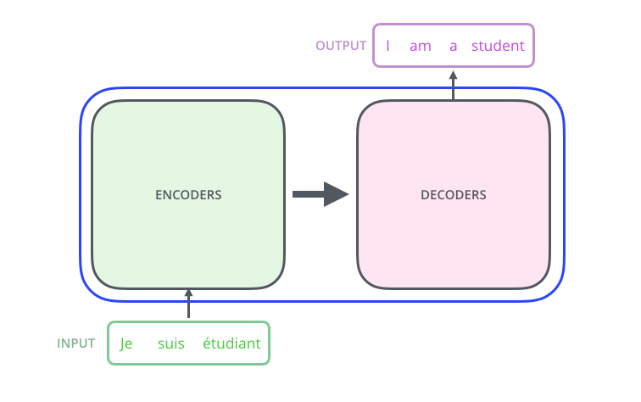
Overview

Slide 9
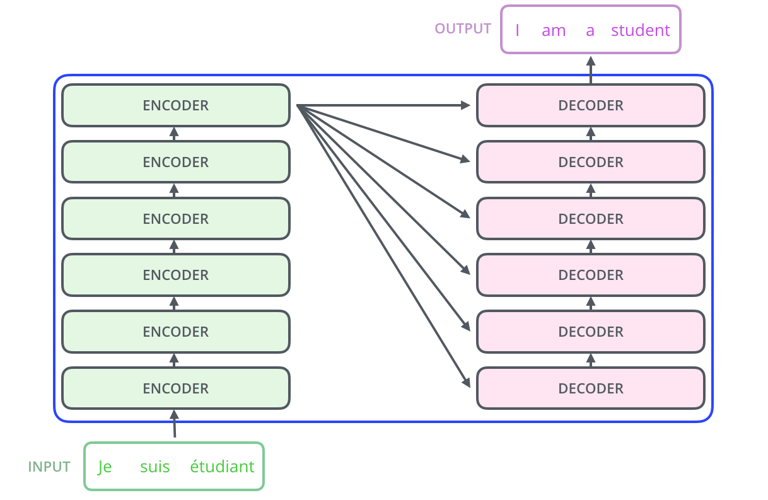
Overview
http://nlp.seas.harvard.edu/2018/04/03/attention.html

Slide 10
Encoder & Decoder (1)

Slide 11
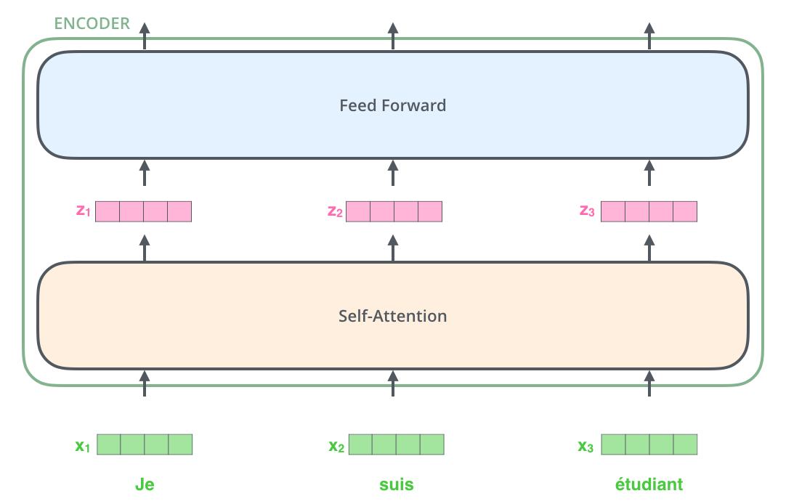
Encoder & Decoder (1)

Slide 12
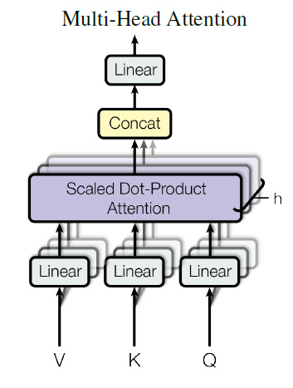
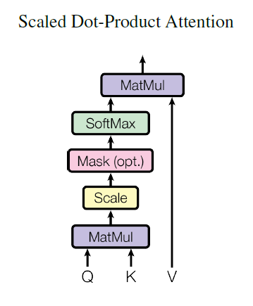
Self (Multi-head) Attention

Slide 13
Self (Multi-head) Attention

Slide 14
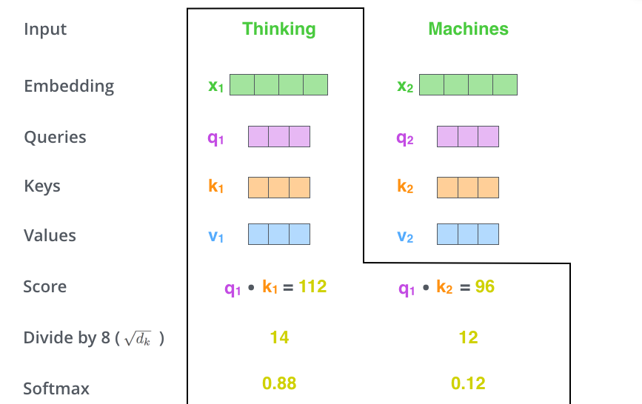
Self (Multi-head) Attention

Slide 15
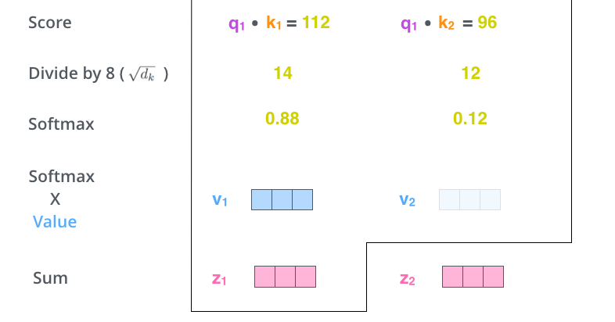
Self (Multi-head) Attention

Slide 16
Self (Multi-head) Attention

Slide 17
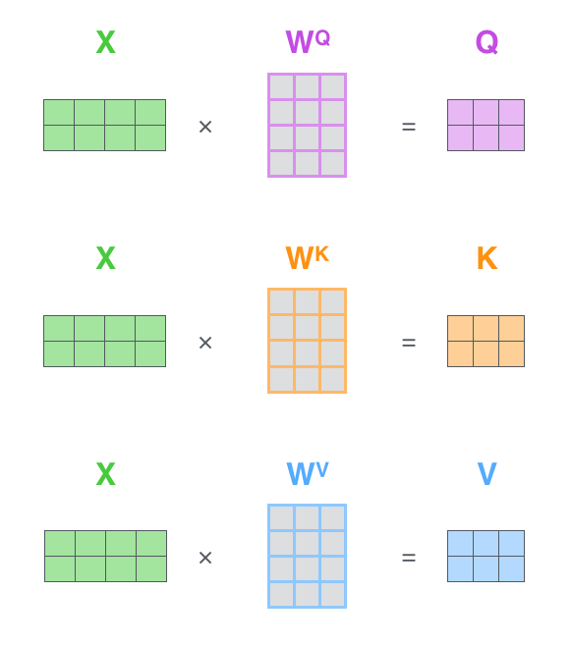
Self (Multi-head) Attention

Slide 18
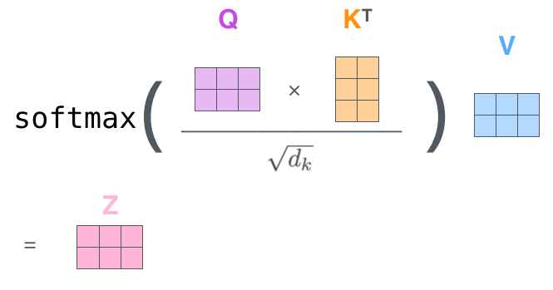
Self (Multi-head) Attention

Slide 19
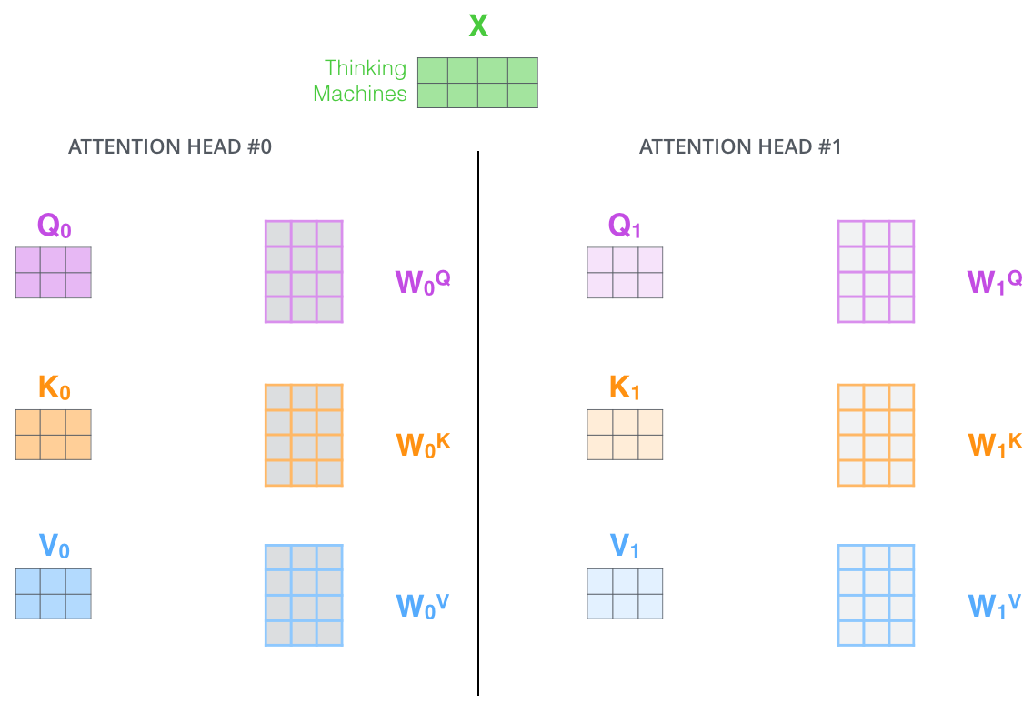
Self (Multi-head) Attention

Slide 20
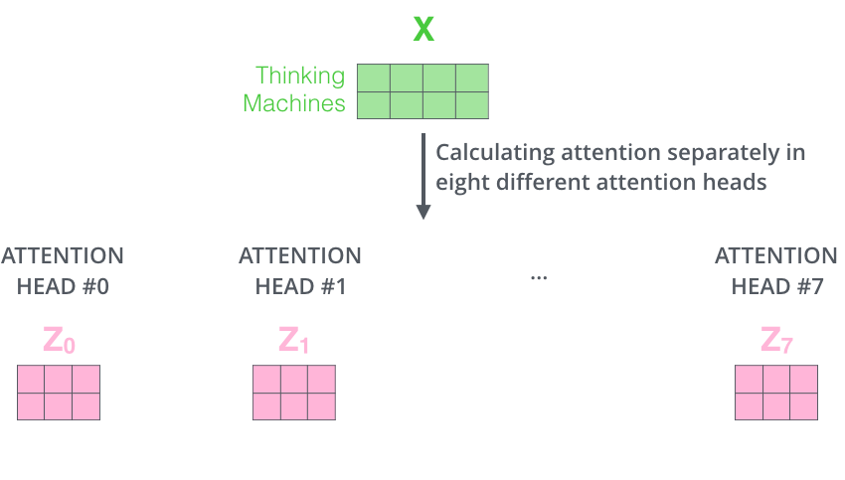
Self (Multi-head) Attention

Slide 21
Self (Multi-head) Attention
3
2
1

Slide 22
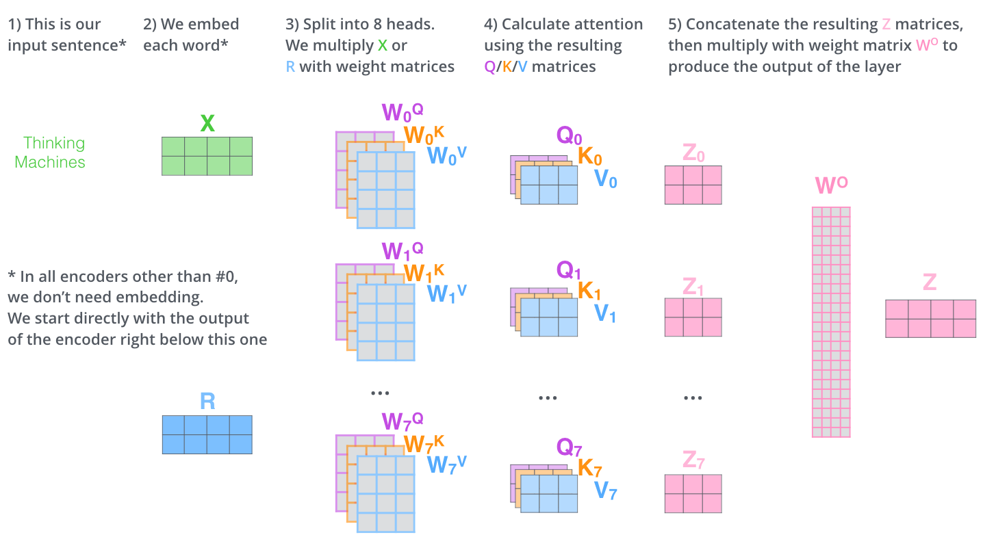
Overview

Slide 23
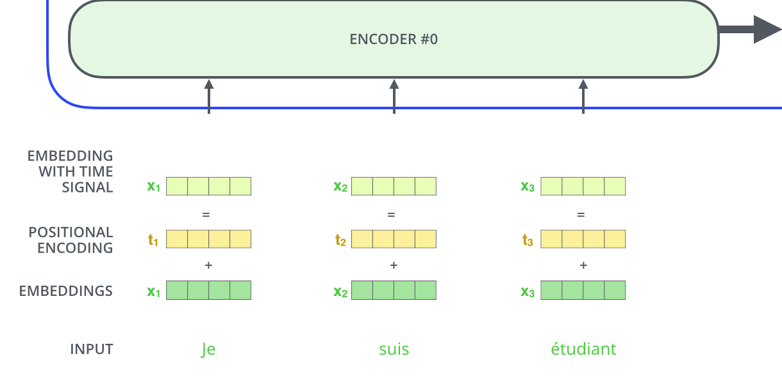
Encoder & Decoder (2)

Slide 24
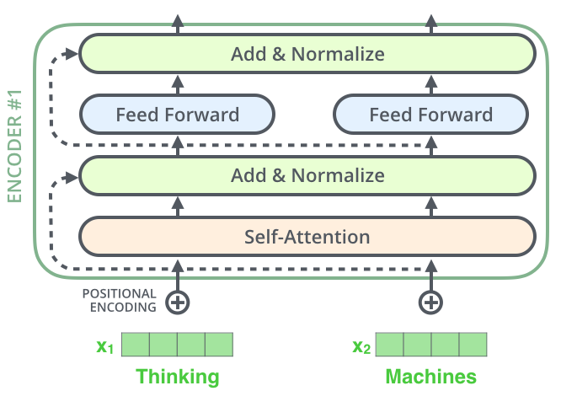
Encoder & Decoder (2)

Slide 25
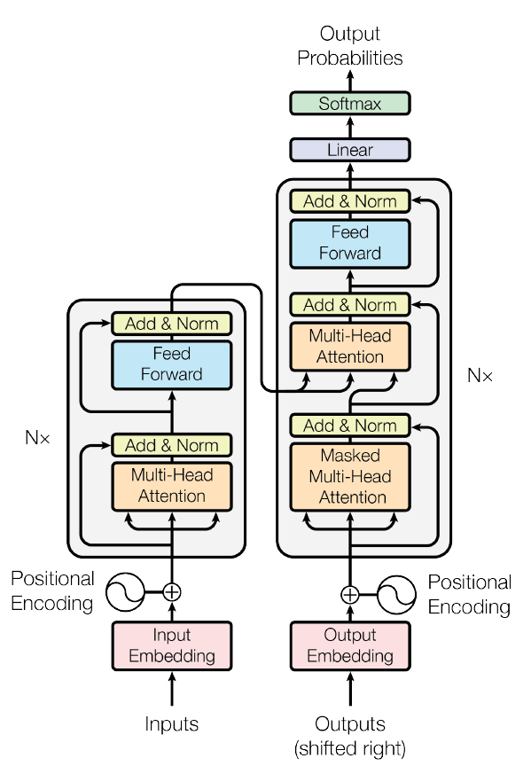
Encoder & Decoder (2)

Slide 26
Result & Conclusion
3
Let’s start with the first set of slides

Slide 27
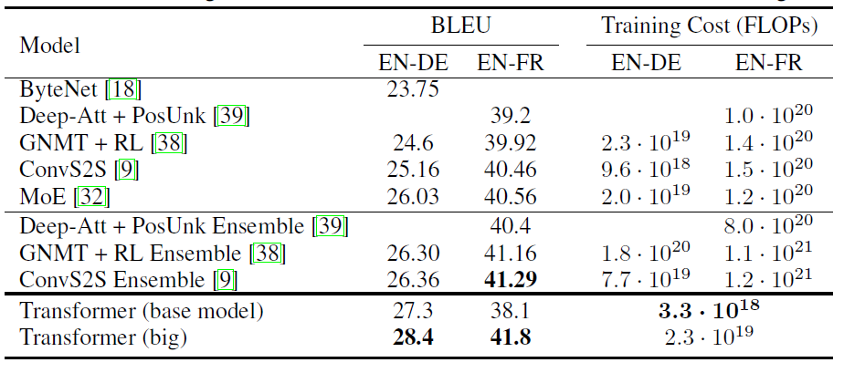
Result

Slide 28
Thank you !

